Slide 1
Employee Management System
Sai Chand Reddy Kamana
SID : 2022785

Slide 2

Introduction
A platform where all work-related as well as important personal details of an employee is stored in a secure way.
manage and search for employees based on different filter conditions.
Administrators and HR in companies uses this application.

Slide 3
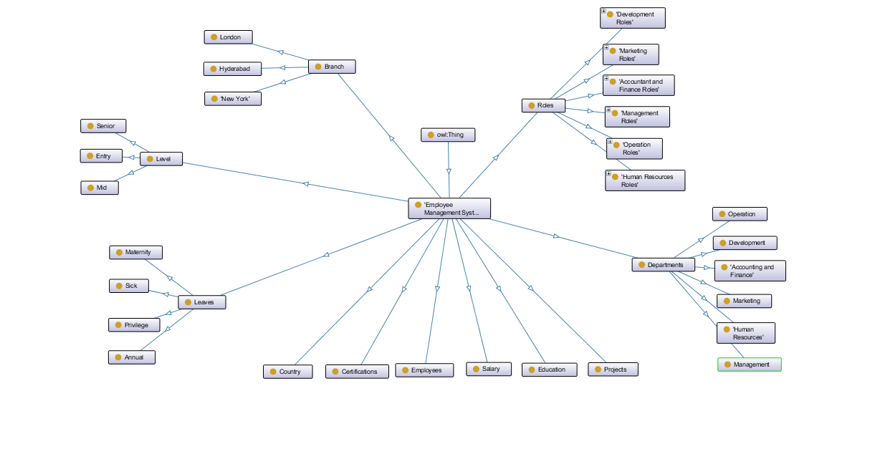
Ontology Graph
Notes:
This is the visual representation of each class available in this ontology using ontograf feature available in the protege.

Slide 4
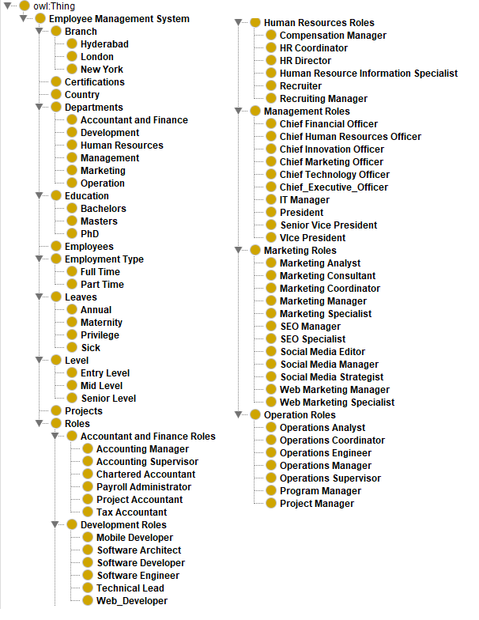
Class Hierarchy
Branches are sub-categorized into Hyderabad, London and New York.
Departments are sub-categorized into 6 depts.
Roles are categorized department wise.
Education, Leaves, Level are categorized into different types.
Notes:
There are total of 11 main classes in the employee management system ontology. Few of them are branch, education, level, roles.

Slide 5
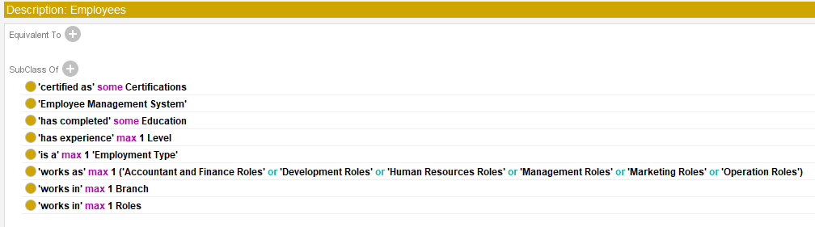
Employee Class
Few conditions like max and some has been added to the employee class.
Notes:
Here for employee class, few conditions are added, like employee can contain multiple certifications and education where as the employee can work either as full-time or part-time employee but not both same as with branches, roles, levels, departments.

Slide 6
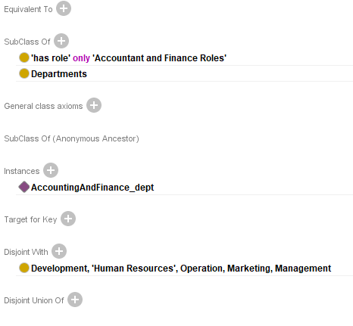
Department Class
Each department contains only set of roles.
Disjoint with other departments.
Notes:
Here, the department class should contains roles that belongs to only that department. For example, Development dept can contain only roles that are specified in the development roles.

Slide 7
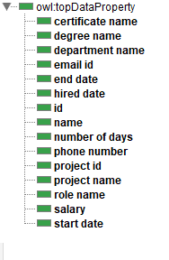
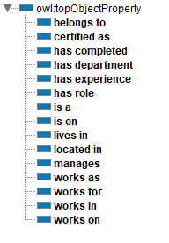
Object Properties
Data Properties
Each object property has its domain and range.
Helps to create relationship between two individuals
Data properties contains values of certain individuals.
Currently, all data properties are string type.
Notes:
Data property and object properties are main for the individuals. Most of the object properties has domain as employee. Suppose, has_completed, has_experience, works_as, works_in are all belongs to the employee class. Belongs_to and has_role are inverse properties like roles belongs_to departments and departments has_role Roles.

Slide 8
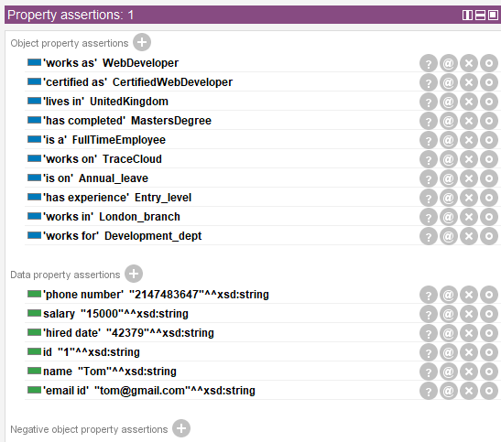
Individual Data
Employee individual with few data properties and object properties.
Can have multiple certifications.
Can work on multiple projects.
If employee is assigned with two different roles, reasoner will throw you an error.
Notes:
Based on conditions specified for employee class, if the user try to add more than 1 role or more than 1 department, the system will thrown an error. There are also few data properties like salary, phone_number, name and email_id are linked with the employee class.

Slide 9
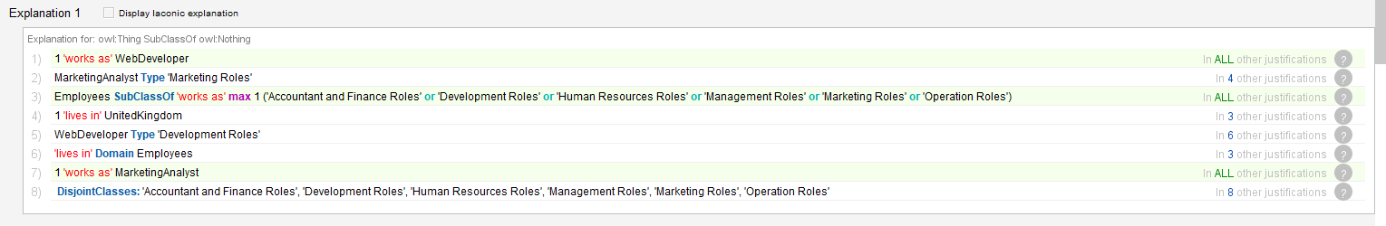
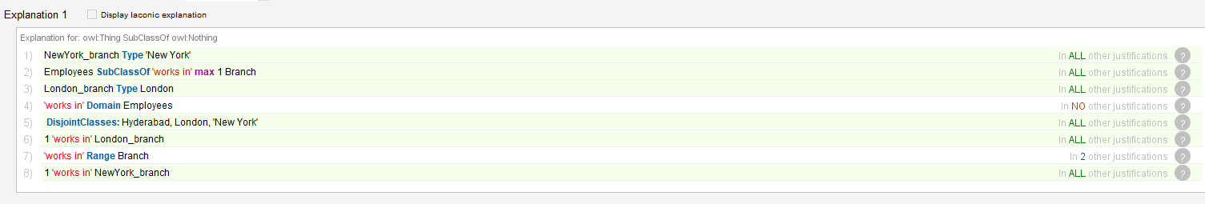
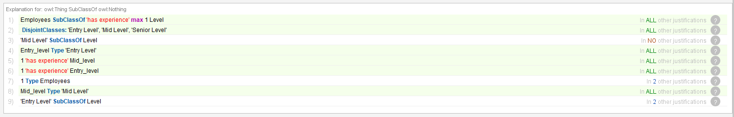
Reasoner Errors
Notes:
These are the few errors that reasoner shown when employee is linked with multiple individuals. In the first picture, reasoner thrown an error when employee individual is linked with both web developer and marketing analyst roles. Same with second and third picture, thrown an error, when linked with two branches and two experience level respectively.

Slide 10
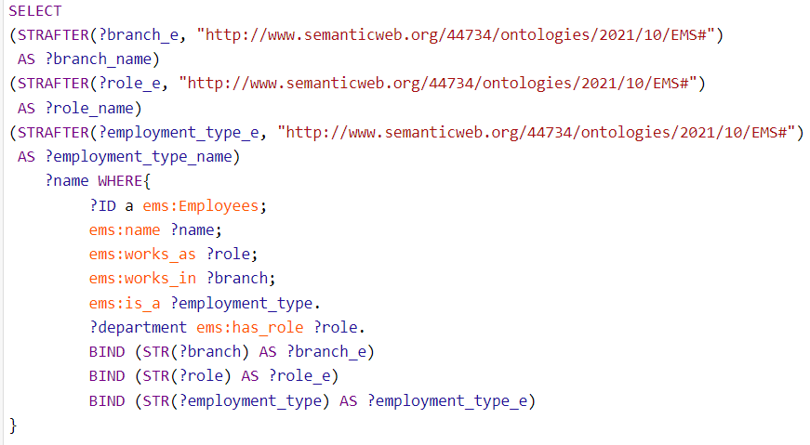
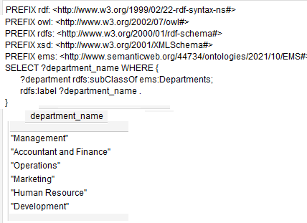
Querying Individuals Using SPARQL
Notes:
Out of few sparql queries, these two are shown in the presentation. In the first picture, the individuals of type employee are queried and before getting the results, the url linked with the object properties are removed using STRAFTER function.
In the second picture, the system shows a list of departments available in the ontology.

Slide 11
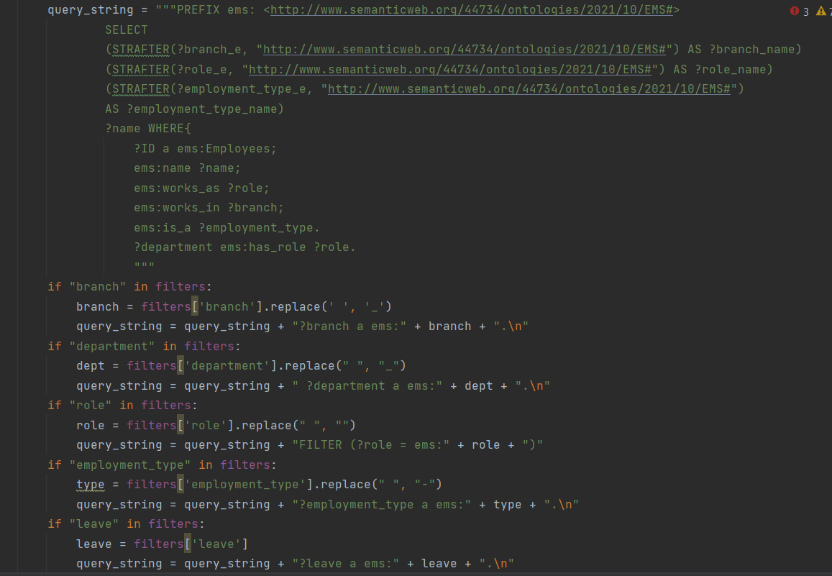
Querying Individual using UI Filters
Notes:
The query shown in this picture is the one used for the system when user select any filter available in the homepage. The query is build based on the filters selected and returns the results that satisfy the user filter condition.

Slide 12
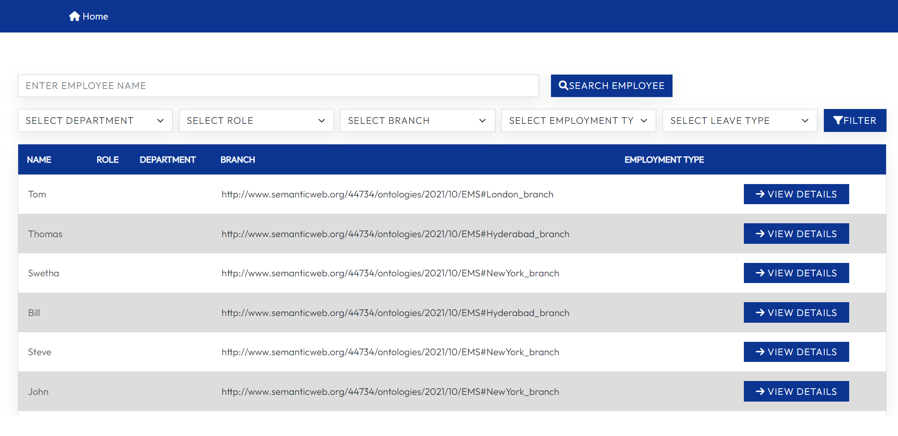
Application Design - Homepage/ Landing Page
This is the landing page of the application. All employees in the database are shown in this page. User can search for employees based on different search conditions.

Slide 13
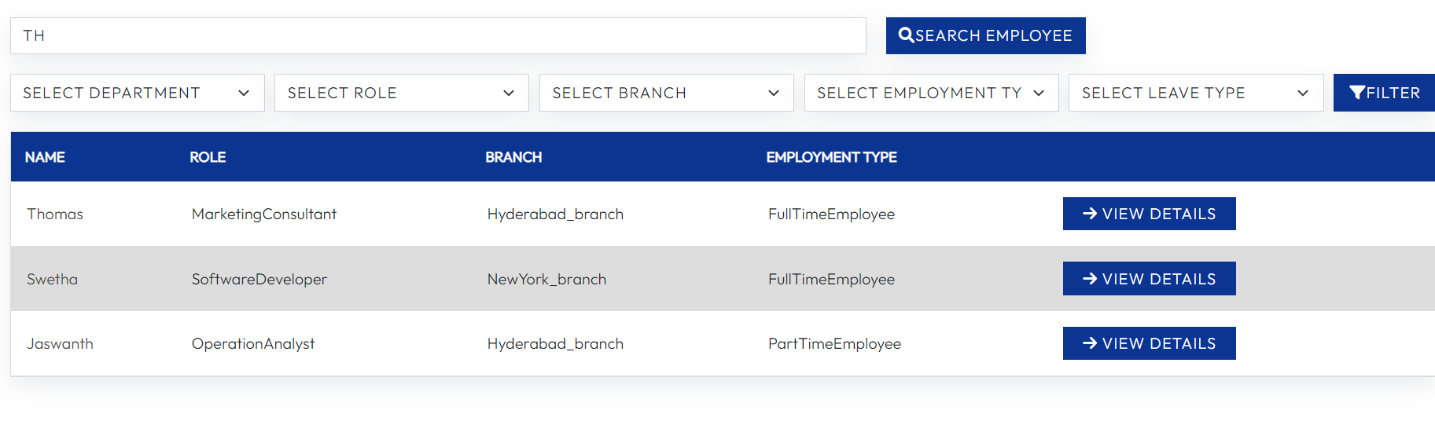
Application Design - Search Using Name
List of employees are shown if their names contains the string provided in the input field. By default, the roles filter will show all the roles listed in the ontology.

Slide 14
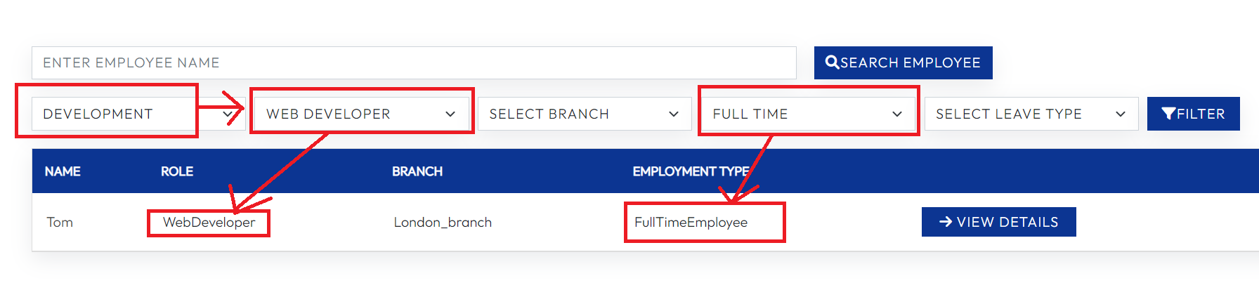
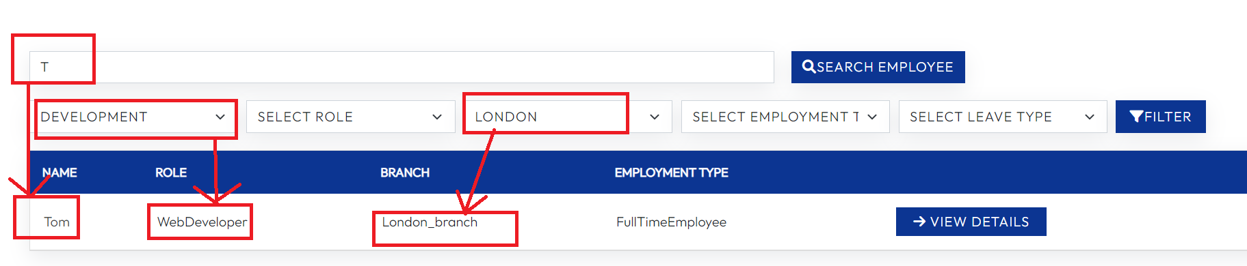
Application Design - Search Using Advanced Filter
Notes:
In the first image, the system returned the results based on the filter conditions passed. If the user selects department options, the options available in the role will automatically updated with the roles that are linked with that department.
In the second image, User can even search for employees using both name field and filter conditions. The name field first queries employees with letter t in their names and then queried employees who works for the development department and then queried again for employees who works in the london branch.

Slide 15
References
Naz, Komal & Siddiqui, Isma & Ali, Qasim & Ali, Saqib. (2019). A Comprehensive Ontology for Human Resource Management in the Context of Software Industry.
Dorn, Jürgen & Naz, Tabbasum & Pichlmair, M. (2007). Ontology development for human resource management. 10.1142/9789812770592_0010.
Sirin, E. (n.d.). Learn SPARQL - Tutorial | Stardog. [online] www.stardog.com. Available at: https://www.stardog.com/tutorials/sparql/ .
SPARQLWrapper Documentation CHANGE_AUTHORS. (2020). [online] Available at: https://sparqlwrapper.readthedocs.io/_/downloads/en/latest/pdf/ .
sparqlwrapper.readthedocs.io. (n.d.). SPARQL Endpoint interface to Python — SPARQLWrapper documentation. [online] Available at: https://sparqlwrapper.readthedocs.io/en/latest/main.html .
Notes:
These are the resources used when developing the ontology.

Slide 16
Thank You

